Slide 1


The Coca-Cola Company - KO
Equity Research Report
12/02/2026

Slide 2
Arial Slide Title – 24
Content/Section Title Text – 14
Bullet and Subtitle Text – 12
Chart, Profile, and Currency Text – 10
Agenda
Normal shapes w/ text
Outline: black, ½ pt.
1
Company Overview
204 – 209 – 215
2
Industry Overview
3
Investment Thesis
72 – 80 – 89
4
Valuation
94 – 124 – 158
5
Catalysts and Risks
6
Recommendation
17 – 61 – 99

Slide 3
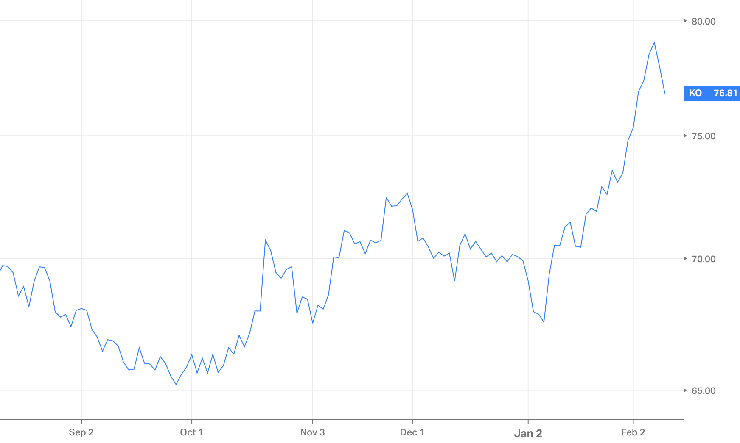
Arial Slide Title – 24
Content/Section Title Text – 14
Bullet and Subtitle Text – 12
Chart, Profile, and Currency Text – 10
Company Overview
Company Highlights
Valuation & Share Performance
History: Founded in 1886 in Atlanta, the company has become the world leader in beverages, operating in more than 200 countries through a unique franchise model. The year 2026 marks a turning point in management with Henrique Braun taking over as CEO to lead a phase of digital acceleration.
Values: “Refresh the world and make a difference” through operational excellence, responsible water management, and circular packaging.
Strategy: Coca-Cola follows an asset-light model focused on concentrates and marketing, delegating bottling to partners. Its Total Beverage vision now incorporates generative AI and digital twins to optimize the supply chain and customer personalization.
Corporate Finance: The group is exceptionally profitable, with an operating margin of 31% in 2025. Its status as a “Dividend King” (63 consecutive years of increases) is supported by robust free cash flow estimated at $12.3 billion for 2026.
Overall: KO is a resilient blue-chip asset and proxy for global consumption. It is a defensive stock that combines historical market dominance with technological flexibility to protect its margins in an inflationary environment.
Key Valuation Statistics
Enterprise Value | $362.2bn | Revenue (FY25) | $47.94bn
Market Cap | $330.4bn | EBITDA (FY25) | $16.01bn
P/E | 25.21x | EBITDA Margin ‘25 | 33.40%
EV/EBITDA | 20.07x | Debt / EV | 1.33x
Cash | $10.27bn | Total Debt | $45.49bn
Normal shapes w/ text
Outline: black, ½ pt.
204 – 209 – 215
Industry Data | Average
Staples Consumer sector
EV/EBITDA – 20.07 | 2.7
EV/Revenue – 7.56 | 12.1
P/E – 25.21 | 32.59
Key Metrics | Unit
Gross Margin | 61.63%
ROE | 43.32%
ROA | 9.11%
Cash ratio | 0.21
Debt to Equity | 1.33
Pretax Margin | 27.34%
Share Price | Current: $76.81 | High/Low: $79.20 / $63.66
72 – 80 – 89
94 – 124 – 158
Revenue Mix | % | Gross (bn)
Concentrate Operations | 59% | $27.73
Finished Product Operations | 41% | $19.34
17 – 61 – 99

Slide 4
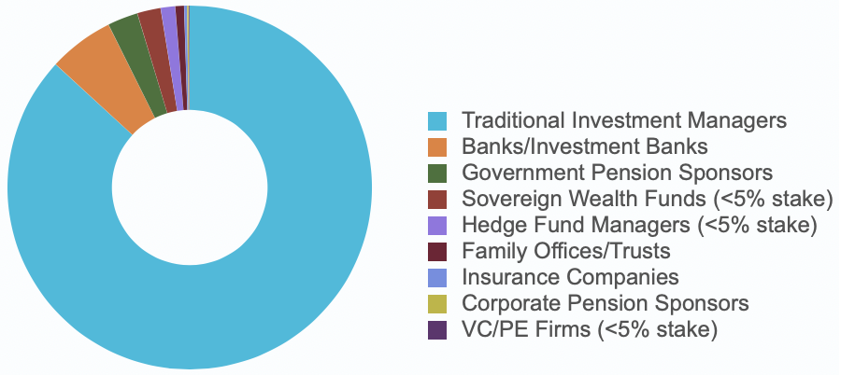
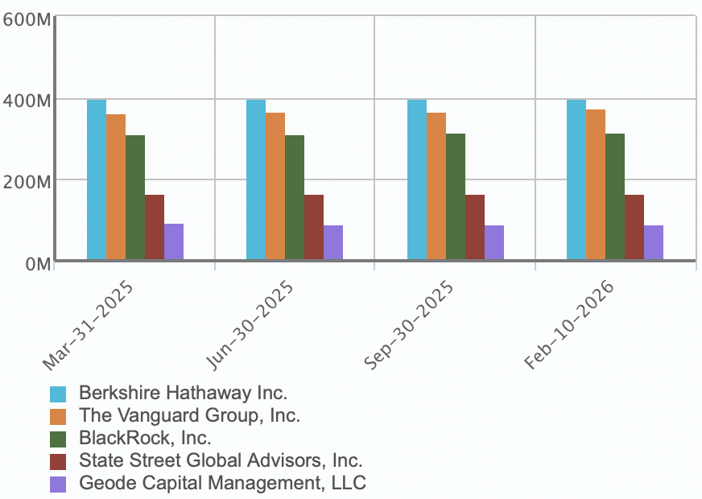
Arial Slide Title – 24
Content/Section Title Text – 14
Bullet and Subtitle Text – 12
Chart, Profile, and Currency Text – 10
Coca-Cola Business Model
Operational Segments
Shareholders Analysis
Coca-Cola generates its revenue primarily through the sale of concentrates to its bottling partners, its global franchise model, and its Total Beverage portfolio.
The group relies on three major operational pillars:
Asset-Light Franchise Model: Coca-Cola focuses on high-margin concentrate production and brand marketing, while delegating capital-intensive bottling and distribution to a global network of independent partners.
Global scale and local agility: Operations are structured by geographic region (North America, EMEA, Latin America, Asia-Pacific) to balance the power of a global brand with precise local execution on pricing and flavors.
Diversified portfolio strategy: Beyond sodas, the group is developing multi-billion-dollar brands in sports, coffee, and dairy (fairlife), integrating AI to accelerate innovation and supply chain efficiency.
Normal shapes w/ text
Outline: black, ½ pt.
204 – 209 – 215
72 – 80 – 89
94 – 124 – 158
17 – 61 – 99
ESSEC Capital Investments Club

Slide 5
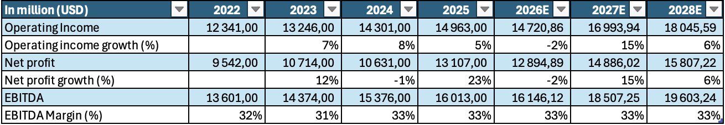
Arial Slide Title – 24
Content/Section Title Text – 14
Bullet and Subtitle Text – 12
Chart, Profile, and Currency Text – 10
Operating Forecast
Normal shapes w/ text
Outline: black, ½ pt.
204 – 209 – 215
Revenue drivers:
Organic growth and price/volume mix: Management is targeting organic revenue growth of 4% to 5% for 2026, based on robust pricing power that has already generated a 4% increase in the “Price/Mix” segment in 2025. The group expects unit volumes to normalize after a stable 2025, promoting a sustainable balance between price increases and consumption.
Technological acceleration through AI: The $1.1 billion partnership with Microsoft enables the deployment of generative AI to personalize marketing and optimize production through “digital twins.” These innovations have already increased supply chain efficiency by 15% and aim to reduce time to market for new products by 30%.
Expansion of the Total Beverage portfolio: The Coca-Cola Zero Sugar segment, growing 14% in 2025, remains a key driver in capturing the 72% of global consumers seeking to reduce their sugar intake. Diversification continues with double-digit success for fairlife (premium dairy products) and the international expansion of BODYARMOR in Europe.
Dynamic emerging markets and asset-light model: Latin America outperformed at the end of 2025 with 8% organic growth (-5% growth for the group in Q4), while the refranchising of bottling operations in India generated a gain of $102 million. This franchise strategy maintains a high EBITDA margin of 33% while minimizing capital requirements.
Financial acceleration (2027-2028): After a transition phase in 2026, projections indicate a massive 15% rebound in operating income growth in 2027 to reach $16.99 billion. In 2028, operating income is expected to exceed $18.05 billion, supported by stabilizing margins and increased operational efficiency.
72 – 80 – 89
94 – 124 – 158
17 – 61 – 99
ESSEC Capital Investments Club

Slide 6
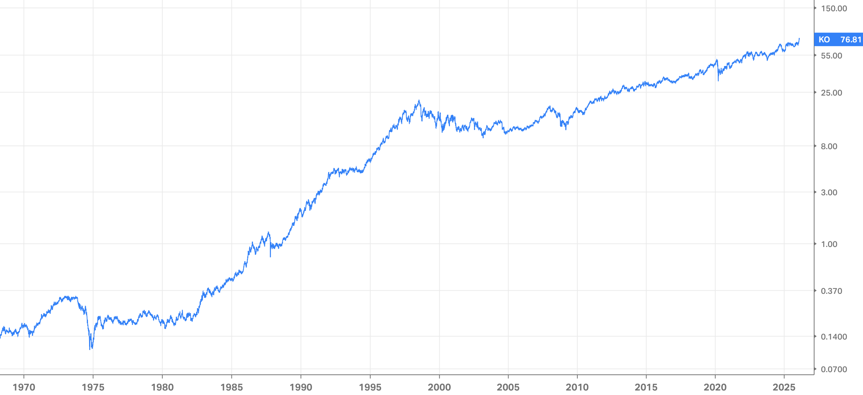
Arial Slide Title – 24
Content/Section Title Text – 14
Bullet and Subtitle Text – 12
Chart, Profile, and Currency Text – 10
Historical Share Price Analysis
10
8
9
Normal shapes w/ text
7
6
Outline: black, ½ pt.
204 – 209 – 215
4
5
3
1
2
72 – 80 – 89
94 – 124 – 158
1977 – stock splits: shares were divided by 2 (2:1) to make the stock more accessible
1982 – Launch of Diet Coke: first new product to use the Coca-Cola brand since 1886
1985 – The “New Coke” disaster : changing the original formula after 99 years caused a public outcry and marked one of the worst marketing mistakes in history.
1986 – The return of the “Classic” formula and the split: followed by a 3-for-1 stock split
5. 1988 – Warren Buffett's entry ($1.3bn) - validation of “safe haven” status
6. 1999 – The contamination crisis in Belgium
7. 2012 – The 2012 split: new 2:1 split to maintain the stock's liquidity
8. 2018 – The acquisition of Costa Coffee : $5.1 billion buyout marked the strategic pivot towards a “Total Beverage Company”
9. 2020 – temporary decline due to the closure of “out-of-home” consumption channels
10. 2026 – new dividend increase for the 65th consecutive year
17 – 61 – 99
ESSEC Capital Investments Club

Slide 7
Arial Slide Title – 24
Content/Section Title Text – 14
Bullet and Subtitle Text – 12
Chart. Profile. and Currency Text – 10
Agenda
Normal shapes w/ text
Outline: black. ½ pt.
1
Company Overview
204 – 209 – 215
2
Industry Overview
3
Investment Thesis
72 – 80 – 89
4
Valuation
5
Catalysts and Risks
94 – 124 – 158
6
Recommendation
17 – 61 – 99
ESSEC Capital Investments Club

Slide 8


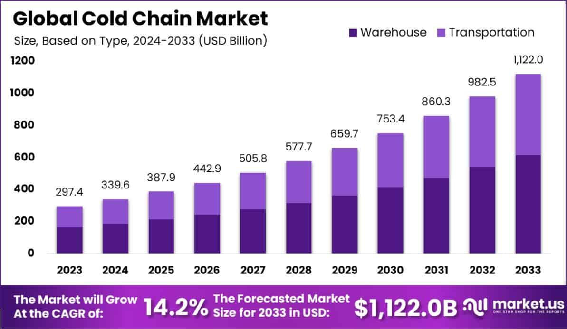
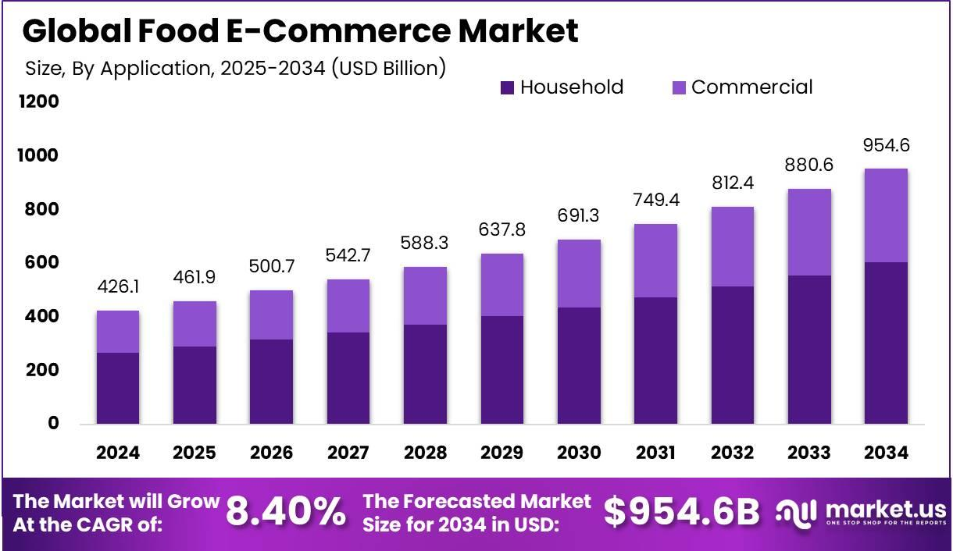
Industry Overview
I. Industry Overview
A demand in infrastructure
Expansion of the cold chain: The global cold chain logistics market is expected to grow from $382.3 billion in 2025 to $1.37 trillion by 2035, driven by growing demand for fresh and perishable food products.
Domestic energy modernization: The European Union plans to install 266 million smart meters by 2030, creating a basic infrastructure for smart home services and household energy efficiency.
Decentralized hubs: The rise of food e-commerce is driving the creation of decentralized cold storage hubs on the urban periphery to reduce delivery windows.
Regional logistics infrastructure: Massive investments in ports (e.g., Port of Caucedo, Colombia) and road networks in Latin America are optimizing trade corridors to the US, facilitating nearshoring.
02/12/2024
Notes:
2

Slide 9
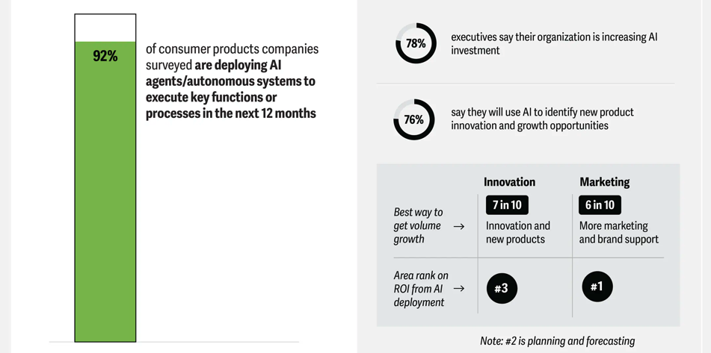
Industry Overview
I. Industry Overview
AI or the magical growth catalyst
Operational AI: By 2026, AI will move from pilot projects to integrated operational layers, automating inventory management, freight purchasing, and warehouse coordination.
Optimization through digital twins: The use of “digital twins” in manufacturing makes it possible to simulate thousands of disruption scenarios, increasing supply chain efficiency by 15%.
Hyper-personalized marketing: Generative AI (via platforms such as Studio X) enables the creation of personalized marketing content at scale, with digital media mix now accounting for approximately 65% of total spending.
Accelerated product innovation: AI reduces time to market for new products by 30% by analyzing consumer trends and flavor profiles in real time.
02/12/2024
Notes:
2

Slide 10
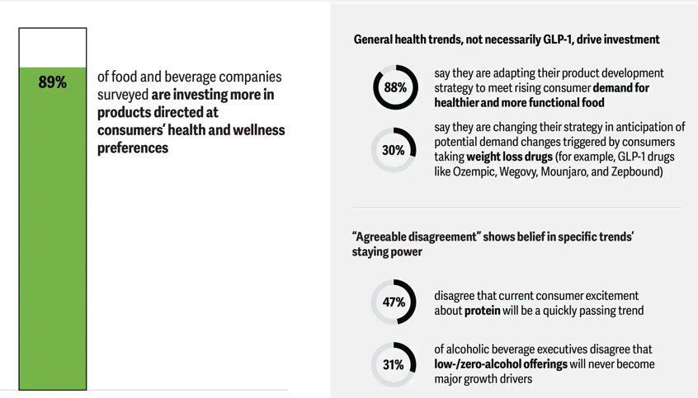
Industry Overview
I. Industry Overview
Key factors
Consumption bifurcation: A gap is emerging between affluent households and “value seekers” (47% of global consumers), forcing brands to aggressively segment their prices.
Surge in “Sugar-Free”: Health is becoming a major revenue driver, illustrated by the 14% growth of the Coca-Cola Zero Sugar segment in 2025.
Pivot to smoke-free: The tobacco industry is undergoing structural change, with smoke-free products (IQOS, nicotine pouches) already accounting for 41% of revenues among industry leaders.
Resilience of e-commerce: Online sales reach 16.3% of total retail sales in the United States, redefining digital visibility as the new currency of exchange.
USMCA regulatory uncertainty: The mandatory review of the trade agreement in 2026 requires increased strategic traceability for agricultural and industrial products in North America.
Post-inflation normalization: Companies are shifting from exclusively price-driven growth to a more balanced mix/volume model after the inflationary shock of 2022-2024.
02/12/2024
Notes:
2

Slide 11
Arial Slide Title – 24
Content/Section Title Text – 14
Bullet and Subtitle Text – 12
Chart, Profile, and Currency Text – 10
Risk Considerations
High Risk
Medium Risk
Low Risk
Normative pressure and ESG criterias
Water security and environmental stress
Normal shapes w/ text
input and tariff margins
Outline: black, ½ pt.
Labor shortage and demographics
204 – 209 – 215
GLP-1 drugs = reduction in global calories consumptions
Low Impact High
72 – 80 – 89
New consumers trends: low-sugar, “premium”, …
Political instability and volatility in currencies
94 – 124 – 158
17 – 61 – 99
Low Probability High
ESSEC Capital Investments Club

Slide 12
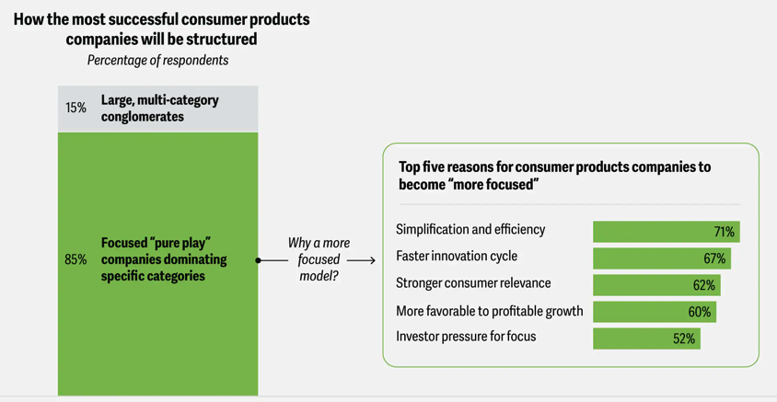
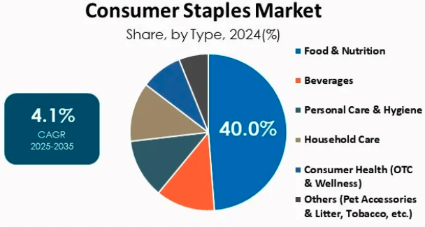
Business Overview - Key Trends
A transitioning sector
Widespread adoption of the “Asset-light” model and managerial profitability: The industry is migrating en masse toward refranchising heavy production and logistics assets (bottling, processing plants, …) to focus on intellectual property and high value-added marketing. This strategy makes it possible to maintain high sector operating margins while protecting the free cash flow needed to maintain “Dividend King” status.
Orchestration of “Decision Intelligence” via agentic AI: AI is no longer just an analytical tool but an integrated operational layer capable of executing autonomous replenishment and inventory management decisions. The intensive use of digital twins in manufacturing generates immediate efficiency gains (15% energy savings) and reduces innovation time-to-market cycles by 30%.
Strategic pivot towards functionality and preventive health: Faced with a slowdown in mass market segments, the sector is making a radical shift towards products with “perceived benefits” (zero sugar, enriched proteins, personalized nutrition) to justify high pricing power. This pivot towards functional products (e.g., sports drinks, premium dairy products) compensates for the erosion of traditional volumes and meets the demand of 72% of global consumers who want to reduce their sugar intake.
Global-local agility: The sector is restructuring its networks around “local-for-local” and “nearshoring” to protect margins against geopolitical and tariff volatility. This resilience is based on modular networks capable of instant scenario simulations and formulation flexibility that allows raw materials to be substituted (e.g., switching from aluminum to plastic) in response to cost shocks.
Notes:
2

Slide 13
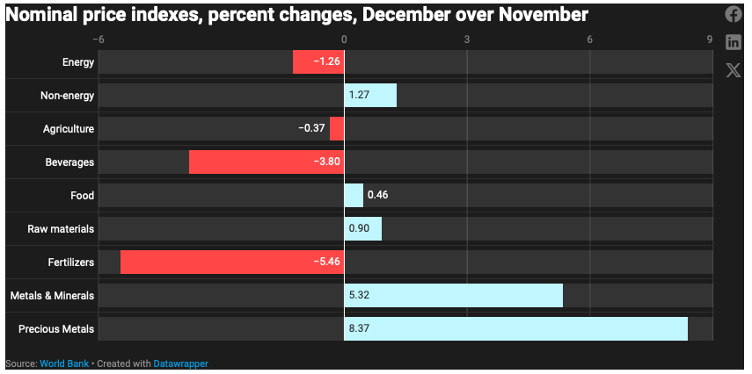
Business Overview - Key Trends
Key trends for the industry: short term
Organic growth target: The sector expects revenue growth of 4% to 7% in 2026, supported by price normalization and volume stabilization.
Easing of raw material prices: The World Bank forecasts an average 7% decline in global commodity prices in 2026, providing tactical relief for EBIT margins.
Tariff lag effect: The increase in import prices linked to customs duties is expected to be fully passed on to the end consumer by the end of 2026.
Notes:
4

Slide 14
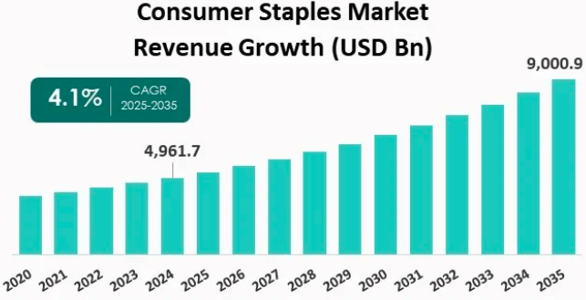
Business Overview - Key Trends
Key trends for the industry: medium term
Acceleration of digital profitability: The sector's operating income is expected to rebound significantly thanks to the efficiency gains achieved through automation and AI.
Expansion of digital revenues: The industry is targeting a 25% share of total revenues from digital sales channels by 2028.
Simplification of portfolios: An increase in divestitures of non-strategic local brands is expected in order to refocus capital on scalable global platforms.
Notes:
4

Slide 15
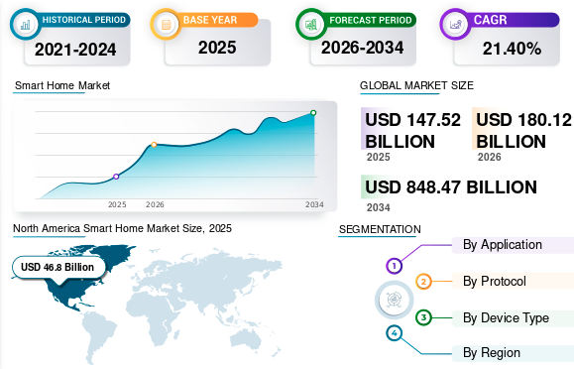
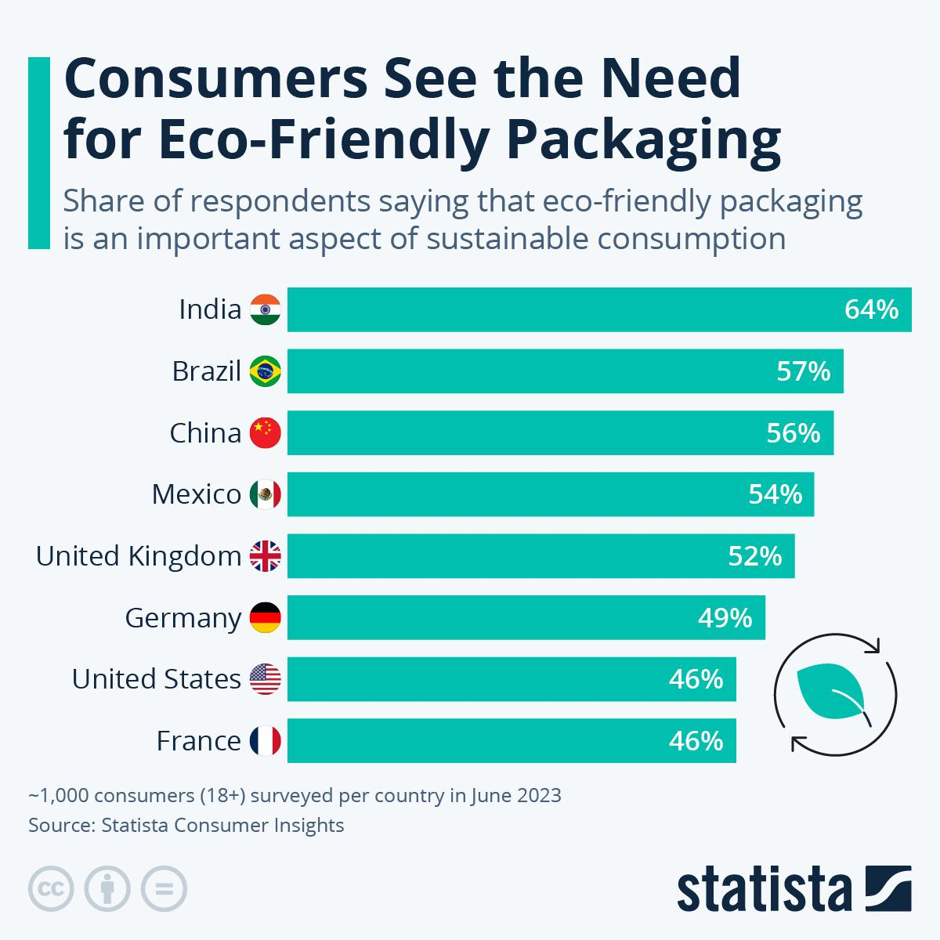
Business Overview - Key Trends
I. Industry Overview
Key trends for the industry: long term
Home Automation and Services: The home automation market is expected to reach $211.2 billion by 2031, redefining home care services.
Global Education: The sector is expected to be worth $10.4 trillion by 2030, driven by a 12% penetration of online learning.
2035 Sustainability Goals: Inclusion of 35-40% recycled materials in all global packaging and return of more than 100% of water used to ecosystems.
Notes:
4

Slide 16
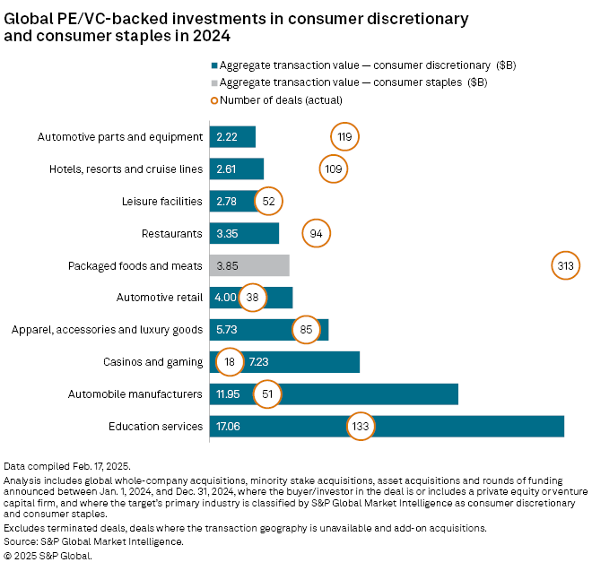
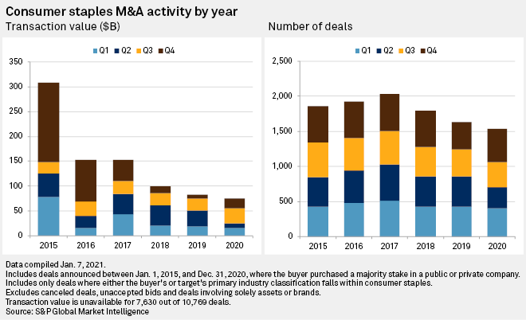
Business Overview - Competitive Landscape
I. Industry Overview
M&A, VC & PE deals
Strategic divestitures: Giants are simplifying their structures, as seen in the spin-off of Unilever's ice cream division and the potential exit from retail for Costa Coffee.
Major consolidation: Acquisition of Kellanova by Mars ($36 billion) to dominate the global snacking segment.
Private equity offensives: Increase in take-privates of undervalued companies, such as Walgreens Boots Alliance by Sycamore Partners.
Healthcare mega-mergers: Acquisition of Kenvue by Kimberly-Clark for $48.7 billion, creating an undisputed leader in consumer healthcare.
VC and clean-label brands: Massive funding for agri-food startups focused on transparency and nutrition (e.g., $51 million for The Whole Truth).
Notes:
3

Slide 17
Arial Slide Title – 24
Content/Section Title Text – 14
Bullet and Subtitle Text – 12
Chart, Profile, and Currency Text – 10
Agenda
Normal shapes w/ text
Outline: black, ½ pt.
1
Company Overview
204 – 209 – 215
2
Industry Overview
3
Investment Thesis
72 – 80 – 89
4
Valuation
94 – 124 – 158
5
Catalysts and Risks
6
Recommendation
17 – 61 – 99
ESSEC Capital Investments Club

Slide 18
Arial Slide Title – 24
Content/Section Title Text – 14
Bullet and Subtitle Text – 12
Chart, Profile, and Currency Text – 10
Investment Thesis
Coca-Cola holds the title of “Dividend King” with 64 consecutive years of dividend increases. Its current yield (2.65%) significantly outperforms the S&P 500 average.
The group generates massive free cash flow (FCF), projected at $12.3 billion in 2026, providing complete flexibility to fund dividends, share buybacks, and innovation.
Strong and predictable dividend yield
Normal shapes w/ text
Outline: black, ½ pt.
Structural resilience via the “Total Beverage” model
The strategic transition to a “Total Beverage Company” diversifies revenues beyond traditional sodas, focusing on high-growth segments such as premium dairy products (fairlife), sports drinks, and coffee.
Its asset-light model (bottling franchise) and pricing power enable it to maintain exceptional operating margins of 31%, protecting profitability against raw material inflation.
204 – 209 – 215
72 – 80 – 89
Digital acceleration and growth through AI
A $1.1 billion strategic partnership with Microsoft deploys generative AI to personalize marketing and uses “digital twins” to increase supply chain efficiency by 15%.
For 2026, management targets organic growth of 4-5% and comparable EPS growth of 7-8%, driven by agile local execution in pivotal emerging markets such as India and China.
94 – 124 – 158
17 – 61 – 99
ESSEC Capital Investments Club

Slide 19
Arial Slide Title – 24
Content/Section Title Text – 14
Bullet and Subtitle Text – 12
Chart, Profile, and Currency Text – 10
Agenda
Normal shapes w/ text
Outline: black, ½ pt.
1
Company Overview
204 – 209 – 215
2
Industry overview
3
Investment Thesis
72 – 80 – 89
4
Valuation
94 – 124 – 158
5
Catalysts and Risks
6
Recommendation
17 – 61 – 99
ESSEC Capital Investments Club

Slide 20
Arial Slide Title – 24
Content/Section Title Text – 14
Bullet and Subtitle Text – 12
Chart, Profile, and Currency Text – 10
Broker estimates
Broker Estimates | Target Prices ($) | Upside (%) | Rating
Evercore (11/02/2026) | $85.00 | +10.7% | Buy
UBS (11/02/2026) | $87.00 | +13.3% | Strong Buy
Jefferies (11/02/2026) | $87.00 | +13.3% | Strong Buy
Wells Fargo (09/02/2026) | $87.00 | +13.3% | Buy
Citigroup (11/02/2026) | $87.00 | +13.3% | Strong Buy
JP Morgan(11/02/2026) | $83.00 | +8.06% | Buy
RBC Capital (11/02/2026) | $87.00 | +13.3% | Buy
Overall average (23 analysts) | $81.93 | +6.67% | Outperform
Normal shapes w/ text
Outline: black, ½ pt.
204 – 209 – 215
72 – 80 – 89
94 – 124 – 158
17 – 61 – 99
ESSEC Capital Investments Club
Notes:
16

Slide 21
DCF Model Output
WACC Assumptions
Cost of Debt
2.92%
As of December 2025, the cost of debt for KO was $868m, for a total book value of net debts of -$29.69m
=> Cost of Debt = 0.868 / 29.69 = 2.92%.
Risk Free Rate
4.16%
We use here the US Treasuries 10Y rate
Cost of Equity
7.71%
We use here a 9.76% market premium, the difference between the risk-free rate and the 10Y return average of the S&P500 Index and the CAPM model then:
Ke = Rf + β * (Rm - Rf) with a β= 0.36
Weight of debt
13.77%
Market cap : $330.41bn / Total debts : $45.49bn
Weight of debt = 45.49 / 330.41 = 13.77%
WACC
6.98%
WACC = (1- weight of debt) * Cost of Equity + weight of debt * Cost of Debt * (1 - Tax Rate)
= (1 – 13.77%) * 7.71% + 13.77% * 2.92% * (1 – 18.61%)
= 6.98%
17 – 61 – 99
ESSEC Capital Investments Club
Notes:
17

Slide 22
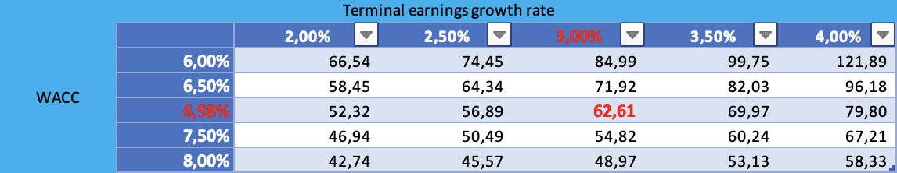
Arial Slide Title – 24
Content/Section Title Text – 14
Bullet and Subtitle Text – 12
Chart, Profile, and Currency Text – 10
DCF Model Output
Terminal Value – Perpetuity Growth Method
2025 FCF : EUR 5.3B
Normal shapes w/ text
FCF growth for the next 5Y : 3%
Baseline Terminal FCF Growth Rate: 3%
Baseline Terminal Value : EUR 299.02B
Diluted shares outstanding : 4,3B
Outline: black, ½ pt.
Net debt : EUR 29.69 B
Baseline EV : EUR 269.33B
204 – 209 – 215
Implied Share Price from DCF
$62.61
Premium to Current Share Price
-18.5%
72 – 80 – 89
Sensitivity Analysis
94 – 124 – 158
17 – 61 – 99
ESSEC Capital Investments Club
Notes:
17

Slide 23
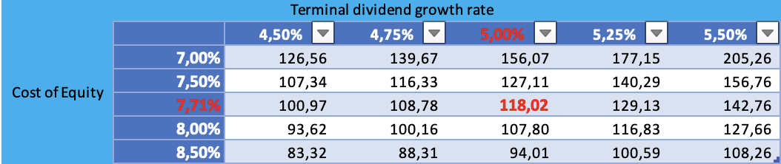
Arial Slide Title – 24
Content/Section Title Text – 14
Bullet and Subtitle Text – 12
Chart, Profile, and Currency Text – 10
DDM Model Output
Terminal Value – Gordon Growth Model
Dividend yield : 2.65%
Normal shapes w/ text
Dividends 2024 : $1.94
Estimated dividends :
 | 2025 | 2026 | 2027 | 2028 | 2029 | 2030 | 2031
dividends | 2,04 | 2,15 | 2,26 | 2,37 | 2,49 | 2,62 | 2,76
PV |  | 1,99 | 1,94 | 1,90 | 1,85 | 1,81 | 1,77
Outline: black, ½ pt.
Dividend growth rate perpetual : 5.00%
204 – 209 – 215
Cost of Equity: 7.71%
Implied Share Price from DDM
$118.02
Premium to Current Share Price
+53.7%
72 – 80 – 89
Sensitivity Analysis
94 – 124 – 158
17 – 61 – 99
ESSEC Capital Investments Club
Notes:
17

Slide 24
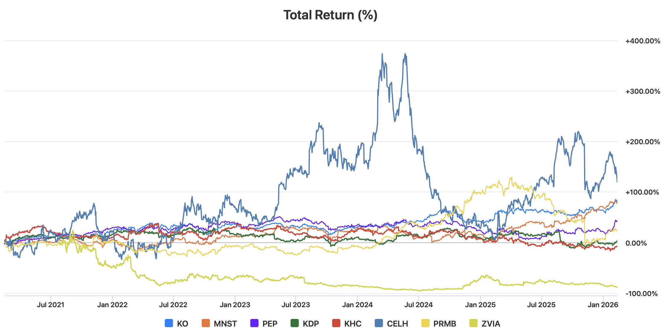
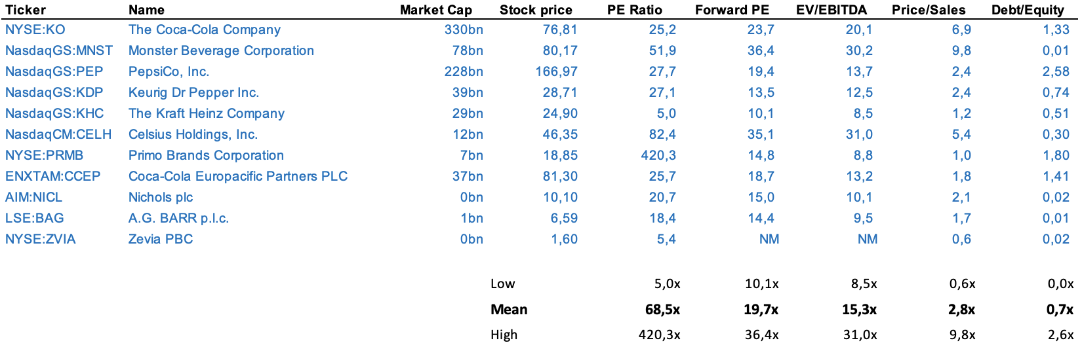
Arial Slide Title – 24
Content/Section Title Text – 14
Bullet and Subtitle Text – 12
Chart, Profile, and Currency Text – 10
Comparables Analysis
Key similarities: These firms manage diversified energy portfolios spanning oil, gas, and increasingly, renewable energy projects. TotalEnergies can remain competitive by accelerating its transition toward low-carbon energy while maintaining profitability in its traditional operations. Like Shell and BP, it invests heavily in renewables and LNG, but its balanced strategy between hydrocarbons and clean energy helps it sustain strong returns while preparing for long-term decarbonization.
Normal shapes w/ text
Outline: black, ½ pt.
94 – 124 – 158
17 – 61 – 99
ESSEC Capital Investments Club
Notes:
16

Slide 25
Arial Slide Title – 24
Content/Section Title Text – 14
Bullet and Subtitle Text – 12
Chart, Profile, and Currency Text – 10
Comparables Analysis: M&A Transactions
Normal shapes w/ text
Outline: black, ½ pt.
Low | 57.12bn | 14.37bn | 3.2x | 13.4x
Mean | 57.12bn | 14.37bn | 3.2x | 13.4x
High | 57.12bn | 14.37bn | 3.2x | 13.4x
94 – 124 – 158
17 – 61 – 99
ESSEC Capital Investments Club
Notes:
16

Slide 26
Arial Slide Title – 24
Content/Section Title Text – 14
Bullet and Subtitle Text – 12
Chart, Profile, and Currency Text – 10
Comparables Analysis: Multiples Valuation
Normal shapes w/ text
 | PE Ratio | Forward PE | EV/EBITDA | Price/Sales
The Coca-Cola Company | 25.21x | 23.72x | 20.07x | 6.89x
Mean peers & M&A | 68.50x | 19.70x | 15.12x | 2.88x
xValuation (bn) | $897.27 | $283.56 | $242.16 | $138.00
price / share | $208.57 | $65.91 | $56.29 | $32.08
Outline: black, ½ pt.
94 – 124 – 158
17 – 61 – 99
ESSEC Capital Investments Club
Notes:
16

Slide 27
Arial Slide Title – 24
Content/Section Title Text – 14
Bullet and Subtitle Text – 12
Chart, Profile, and Currency Text – 10
Agenda
Normal shapes w/ text
Outline: black, ½ pt.
1
Company Overview
204 – 209 – 215
2
Investment Thesis
3
Investment Thesis
72 – 80 – 89
4
Valuation
94 – 124 – 158
5
Catalysts and Risks
6
Recommendation
17 – 61 – 99
ESSEC Capital Investments Club

Slide 28
Arial Slide Title – 24
Content/Section Title Text – 14
Bullet and Subtitle Text – 12
Chart, Profile, and Currency Text – 10
Risk Considerations
High Risk
Medium Risk
Low Risk
short-term slowdown in profitability
Water security and environmental stress
Normal shapes w/ text
Threats to margins related to raw materials and tariffs
Outline: black, ½ pt.
Coca-Cola’s tax dispute with the IRS
204 – 209 – 215
BodyArmor competitiveness with regards to Gatorade, prime, …
Low Impact High
72 – 80 – 89
Managerial transition with a new CEO
Political instability and volatility in currencies
94 – 124 – 158
17 – 61 – 99
Low Probability High
ESSEC Capital Investments Club

Slide 29
Arial Slide Title – 24
Content/Section Title Text – 14
Bullet and Subtitle Text – 12
Chart, Profile, and Currency Text – 10
Agenda
Normal shapes w/ text
Outline: black, ½ pt.
1
Company Overview
204 – 209 – 215
2
Investment Thesis
3
Investment Thesis
72 – 80 – 89
4
Valuation
5
Catalysts and Risks
94 – 124 – 158
6
Recommendation
17 – 61 – 99
ESSEC Capital Investments Club

Slide 30
Arial Slide Title – 24
Content/Section Title Text – 14
Bullet and Subtitle Text – 12
Chart, Profile, and Currency Text – 10
Price Target & Recommendation
Price Target
We believe that under $80, KO is a low-risk play and therefore a buy for our core portfolio.
Our price target is $90, giving us a 17% upside, but this is a short to medium-term play.
A stop in the 64-year continuous increase in dividends is where we could consider selling before our price target.
We put a stop loss at $65.
Normal shapes w/ text
Valuation Summary
Analysis | Price | Weight
Current price | $76.81 | 10%
Brokers | $81.93 | 20%
Comparables | $90.71 | 20%
DCF | $62.61 | 20%
DDM | $118.02 | 30%
Target Price | $90.14 | 100%
Outline: black, ½ pt.
204 – 209 – 215
72 – 80 – 89
94 – 124 – 158
17 – 61 – 99
ESSEC Capital Investments Club
Notes:
21

